Slide 1
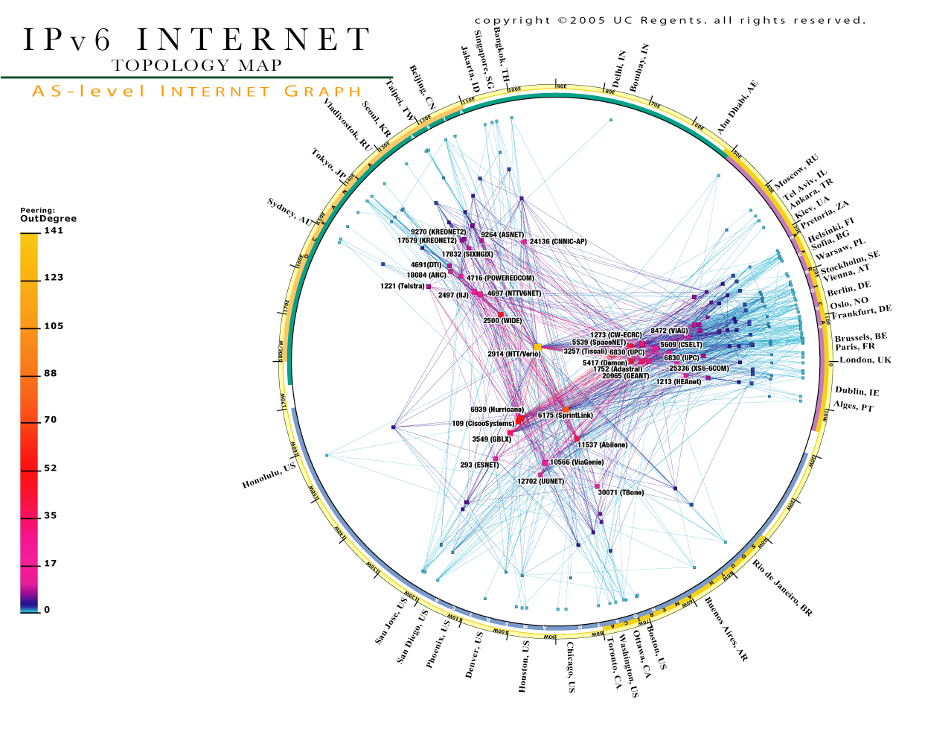
Topic 4: Internetworking
Notes:
http://www.kk.org/thetechnium/barilan_internet-thumb.jpg

Slide 2
Topic’s objectives
To find out about:
1 – IP Control Messaging: ICMP
2 – IP Next-Generation: IPv6

Slide 3
Internet Control Message Protocol (ICMP)

Slide 4
Why is ICMP used?
IP is best effort; i.e., packets can be:
Lost, delayed, duplicated, delivered out of order, corrupted.
Best-effort, however, does not mean careless
IP attempts to avoid/ detect errors (without guarantees)
ICMP is used for:
Error reporting
Information querying

Slide 5
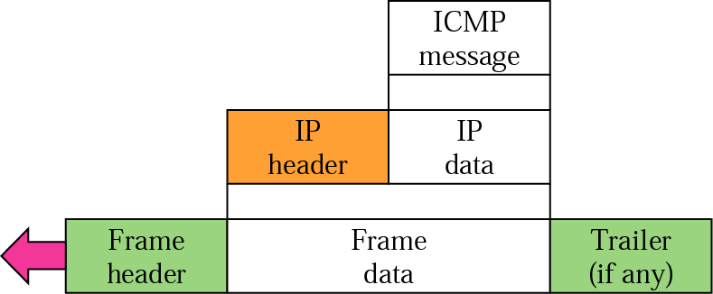
ICMP Encapsulation

Slide 6
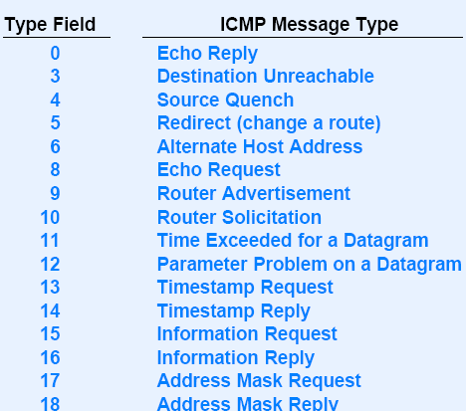
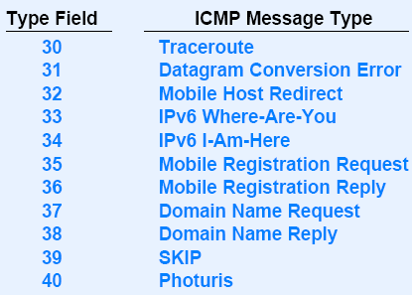
ICMP Message Types
Notes:
This hidden slide is for the reference of the students

Slide 7
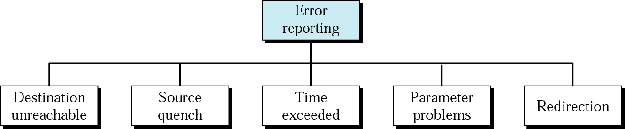
ICMP Error Messages
Sent when a router determines that a packet cannot be delivered.
It is specified whether destination host is unreachable or the network
0
8
16
31
Type (3)
Code (0 to 12)
Checksum
Identifier
Sequence Number
Optional data
. . .
Notes:
From Douglas Comer’s book ‘Computer Networks and Internets’:
Source Quench: A router sends a source quench whenever it has received so many datagram that it has not more buffer space available. A router that has temporarily run out of buffer must discard incoming datagram. When it discards a datagram, the router sends a source quench message to the host that created the datagram.
Time exceeded: This error message is sent in two cases:
TTL is decremented to zero: When a router reduces the Time to Live (TTL) field in an IP datagram to zero, it sends a time exceeded message to the source of the datagram.
Reassembly timer expires before all fragments of a packet arrive at the destination.
Destination Unreachable:
When a router determines that a packet cannot be delivered to its final destination, the router sends a destination unreachable message to the host that created the datagram. The message specifies whether the specific destination host is unreachable, or the network to which the destination attaches is unreachable.
In other words, the error message distinguishes between a situation in which an entire network is temporarily disconnected from the Internet (e.g., when a router has failed), or when a particular host is temporarily offline (e.g., because the host is powered down)
Redirect:
If a router determines that a host has incorrectly sent a datagram that should be sent to a different router, the router uses a redirect message to cause the host to change its route. A redirect message can specify either a change for a specific host or a change for a network; the latter is more common.
Parameters problem
One of the parameter defined in the datagram is incorrect.

Slide 8
ICMP Error Messages
When a router discards a packet due to lack of buffer space, it sends a source quench message to the source host (so that it slows down)
0
8
16
31
Type (4)
Code
Checksum
Identifier
Sequence Number
Optional data
. . .
Notes:
From Douglas Comer’s book ‘Computer Networks and Internets’:
Source Quench: A router sends a source quench whenever it has received so many datagram that it has not more buffer space available. A router that has temporarily run out of buffer must discard incoming datagram. When it discards a datagram, the router sends a source quench message to the host that created the datagram.
Time exceeded: This error message is sent in two cases:
TTL is decremented to zero: When a router reduces the Time to Live (TTL) field in an IP datagram to zero, it sends a time exceeded message to the source of the datagram.
Reassembly timer expires before all fragments of a packet arrive at the destination.
Destination Unreachable:
When a router determines that a packet cannot be delivered to its final destination, the router sends a destination unreachable message to the host that created the datagram. The message specifies whether the specific destination host is unreachable, or the network to which the destination attaches is unreachable.
In other words, the error message distinguishes between a situation in which an entire network is temporarily disconnected from the Internet (e.g., when a router has failed), or when a particular host is temporarily offline (e.g., because the host is powered down)
Redirect:
If a router determines that a host has incorrectly sent a datagram that should be sent to a different router, the router uses a redirect message to cause the host to change its route. A redirect message can specify either a change for a specific host or a change for a network; the latter is more common.
Parameters problem
One of the parameter defined in the datagram is incorrect.

Slide 9
ICMP Error Messages
“Time exceeded” ICMP message sent to datagram source in two cases:
When Time to Live (TTL) is decremented to zero,
When Reassembly timer expires before all fragments arrive at dest.
0
8
16
31
Type (11)
Code (0 or 1)
Checksum
Identifier
Sequence Number
Optional data
. . .
Notes:
From Douglas Comer’s book ‘Computer Networks and Internets’:
Source Quench: A router sends a source quench whenever it has received so many datagram that it has not more buffer space available. A router that has temporarily run out of buffer must discard incoming datagram. When it discards a datagram, the router sends a source quench message to the host that created the datagram.
Time exceeded: This error message is sent in two cases:
TTL is decremented to zero: When a router reduces the Time to Live (TTL) field in an IP datagram to zero, it sends a time exceeded message to the source of the datagram.
Reassembly timer expires before all fragments of a packet arrive at the destination.
Destination Unreachable:
When a router determines that a packet cannot be delivered to its final destination, the router sends a destination unreachable message to the host that created the datagram. The message specifies whether the specific destination host is unreachable, or the network to which the destination attaches is unreachable.
In other words, the error message distinguishes between a situation in which an entire network is temporarily disconnected from the Internet (e.g., when a router has failed), or when a particular host is temporarily offline (e.g., because the host is powered down)
Redirect:
If a router determines that a host has incorrectly sent a datagram that should be sent to a different router, the router uses a redirect message to cause the host to change its route. A redirect message can specify either a change for a specific host or a change for a network; the latter is more common.
Parameters problem
One of the parameter defined in the datagram is incorrect.

Slide 10
ICMP Error Messages
Any of the datagram’s parameter is incorrect
0
8
16
31
Type (12)
Code
Checksum
Identifier
Sequence Number
Optional data
. . .
Notes:
From Douglas Comer’s book ‘Computer Networks and Internets’:
Source Quench: A router sends a source quench whenever it has received so many datagram that it has not more buffer space available. A router that has temporarily run out of buffer must discard incoming datagram. When it discards a datagram, the router sends a source quench message to the host that created the datagram.
Time exceeded: This error message is sent in two cases:
TTL is decremented to zero: When a router reduces the Time to Live (TTL) field in an IP datagram to zero, it sends a time exceeded message to the source of the datagram.
Reassembly timer expires before all fragments of a packet arrive at the destination.
Destination Unreachable:
When a router determines that a packet cannot be delivered to its final destination, the router sends a destination unreachable message to the host that created the datagram. The message specifies whether the specific destination host is unreachable, or the network to which the destination attaches is unreachable.
In other words, the error message distinguishes between a situation in which an entire network is temporarily disconnected from the Internet (e.g., when a router has failed), or when a particular host is temporarily offline (e.g., because the host is powered down)
Redirect:
If a router determines that a host has incorrectly sent a datagram that should be sent to a different router, the router uses a redirect message to cause the host to change its route. A redirect message can specify either a change for a specific host or a change for a network; the latter is more common.
Parameters problem
One of the parameter defined in the datagram is incorrect.

Slide 11
ICMP Error Messages
Sent if a router determines that a host has incorrectly sent datagram that should be sent to different router
Redirect can specify either a change for a host or complete network
0
8
16
31
Type (5)
Code (0 to 3)
Checksum
Identifier
Sequence Number
Optional data
. . .
Notes:
From Douglas Comer’s book ‘Computer Networks and Internets’:
Source Quench: A router sends a source quench whenever it has received so many datagram that it has not more buffer space available. A router that has temporarily run out of buffer must discard incoming datagram. When it discards a datagram, the router sends a source quench message to the host that created the datagram.
Time exceeded: This error message is sent in two cases:
TTL is decremented to zero: When a router reduces the Time to Live (TTL) field in an IP datagram to zero, it sends a time exceeded message to the source of the datagram.
Reassembly timer expires before all fragments of a packet arrive at the destination.
Destination Unreachable:
When a router determines that a packet cannot be delivered to its final destination, the router sends a destination unreachable message to the host that created the datagram. The message specifies whether the specific destination host is unreachable, or the network to which the destination attaches is unreachable.
In other words, the error message distinguishes between a situation in which an entire network is temporarily disconnected from the Internet (e.g., when a router has failed), or when a particular host is temporarily offline (e.g., because the host is powered down)
Redirect:
If a router determines that a host has incorrectly sent a datagram that should be sent to a different router, the router uses a redirect message to cause the host to change its route. A redirect message can specify either a change for a specific host or a change for a network; the latter is more common.
Parameters problem
One of the parameter defined in the datagram is incorrect.

Slide 12
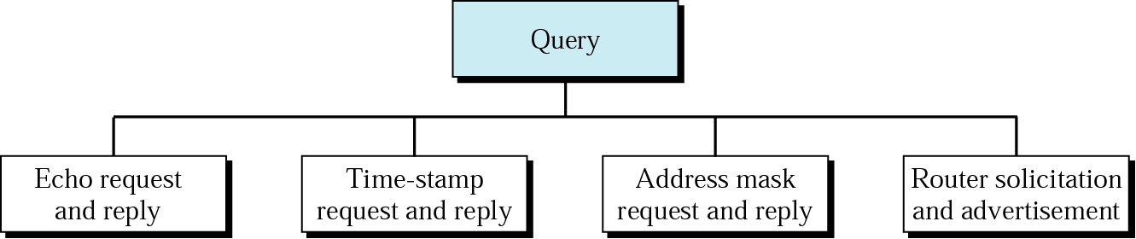
ICMP Information Query Messages
Used by the ping command to determine connectivity between two end-points
0
8
16
31
Type (8 or 0)
Code
Checksum
Identifier
Sequence Number
Optional data
. . .
Notes:
In addition to error messages, ICMP defines information messages that include:
Echo Request/ Reply:
An echo request message can be sent to the ICMP software on any computer. In response to an incoming echo request message, ICMP software is required to send an ICMP echo reply message (in normal course of events; i.e., unless these replies are disabled for security reasons).
2) Address Mask Request/ Reply
A host broadcasts an address mask request when it boots, and routers that receive the request send an address mask reply that contains the correct 32 bit subnet mask being used on the network.

Slide 13
ICMP Information Query Messages
Used for requesting and replying with the system’s time
0
8
16
31
Type (13 or 14)
Code
Checksum
Identifier
Sequence Number
Optional data
. . .
Notes:
In addition to error messages, ICMP defines information messages that include:
Echo Request/ Reply:
An echo request message can be sent to the ICMP software on any computer. In response to an incoming echo request message, ICMP software is required to send an ICMP echo reply message (in normal course of events; i.e., unless these replies are disabled for security reasons).
2) Address Mask Request/ Reply
A host broadcasts an address mask request when it boots, and routers that receive the request send an address mask reply that contains the correct 32 bit subnet mask being used on the network.

Slide 14
ICMP Information Query Messages
Used by hosts at boot up to get information about subnet mask being used
0
8
16
31
Type (17or 18)
Code (0)
Checksum
Identifier
Sequence Number
Optional data
. . .
Notes:
In addition to error messages, ICMP defines information messages that include:
Echo Request/ Reply:
An echo request message can be sent to the ICMP software on any computer. In response to an incoming echo request message, ICMP software is required to send an ICMP echo reply message (in normal course of events; i.e., unless these replies are disabled for security reasons).
2) Address Mask Request/ Reply
A host broadcasts an address mask request when it boots, and routers that receive the request send an address mask reply that contains the correct 32 bit subnet mask being used on the network.

Slide 15
ICMP Information Query Messages
Used by a host to solicit the services of a router
0
8
16
31
Type (10)
Code
Checksum
Identifier
Sequence Number
Optional data
. . .
Notes:
In addition to error messages, ICMP defines information messages that include:
Echo Request/ Reply:
An echo request message can be sent to the ICMP software on any computer. In response to an incoming echo request message, ICMP software is required to send an ICMP echo reply message (in normal course of events; i.e., unless these replies are disabled for security reasons).
2) Address Mask Request/ Reply
A host broadcasts an address mask request when it boots, and routers that receive the request send an address mask reply that contains the correct 32 bit subnet mask being used on the network.

Slide 16
IP next generation: IPv6

Slide 17
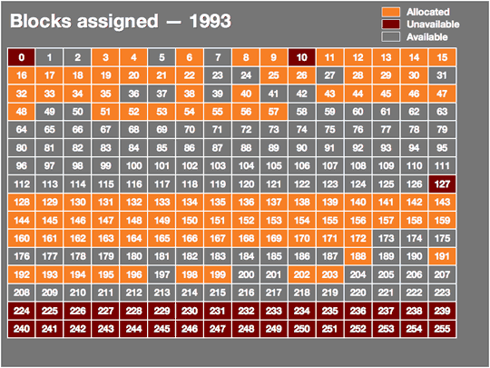
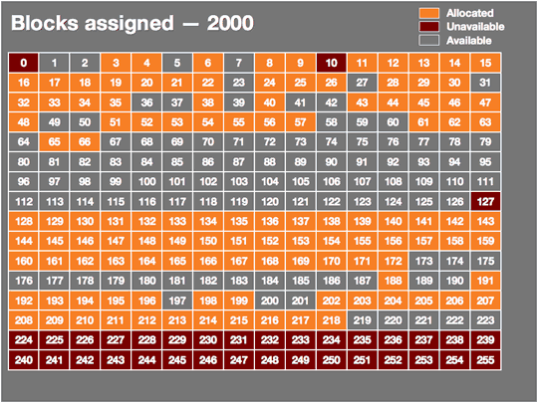
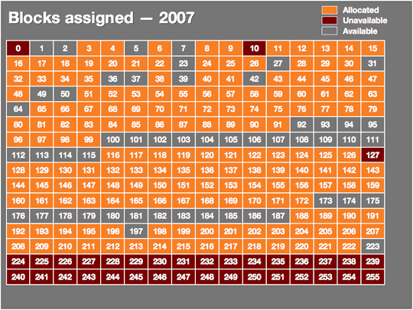
IPv4 allocation/ availability
Sooner or later, we’ll run out of IPv4 (32 bit) addresses
Notes:
http://arstechnica.com/hardware/news/2007/03/IPv6.ars
It is anticipated that even with NAT and private addressing, by 2020 IPv4 address will be depleted. (Douglas Comer)

Slide 18
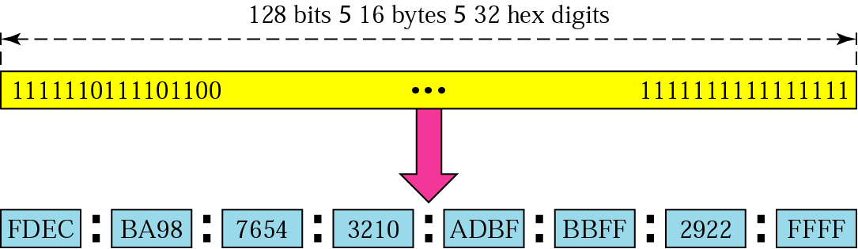
IPv6
Solution: 128 bit IPv6 address
Notes:
128 bits per address
This is a really big increase in capacity; IPv6 has 1024 addresses per square meter of the Earth’s surface!

Slide 19
IPv6 Destination Addresses
Unicast:
Single host receives the packet
Multicast:
A group of hosts receive the packet
Anycast:
Any host from a group of hosts receive the packet

Slide 20
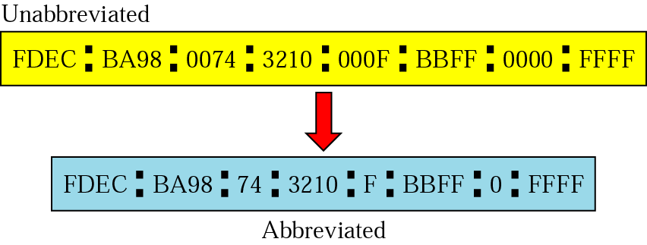
Representing IPv6 addresses
3 conventional forms represent IPv6 addresses
x:x:x:x:x:x:x:x
(8 colon separated fields of 16 bits each represented by 1 to 4 hexadecimal digits)
Not necessary to write leading zero in individual fields

Slide 21
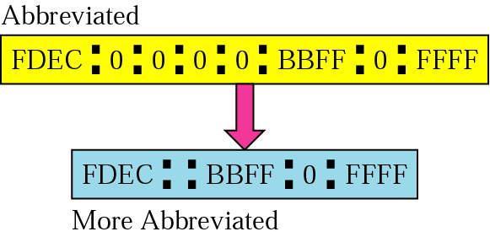
Representing IPv6 addresses
x:x:x:x::x:x
(The same as before except the use of to represent one or both 16 bits of zeros)
::

Slide 22
Representing IPv6 addresses
x:x:x:x:x:x:d.d.d.d
(Used to facilitate IPv4 to IPv6 transition)
For example, IPv4 address: 129.144.52.38 can be extended to an IPv6 address as follows:
0:0:0:0:0:0:129.144.52.38 or
::129.144.52.38
0:0:0:0:0:FFFF:129.144.52.38 or
::FFFF:129.144.52.38

Slide 23
IPv6’s CIDR Support
IPv6 prefixes written as in IPv4 with CIDR as
IPv6-address/prefix-length
Example: 20010DB80000CD3 (hexadecimal)
Legal representations:
2001:0DB8:0000:CD30:0000:0000:0000:0000/60
2001:0DB8::CD30:0:0:0:0/60
2001:0DB8:0:CD30::/60

Slide 24
IPv6’s CIDR Support
IPv6 prefixes written as in IPv4 with CIDR as
IPv6-address/prefix-length
Example: 20010DB80000CD3 (hexadecimal)
Illegal representations:
2001:0DB8:0:CD3/60
2001:0DB8::CD30/60
2001:0DB8::CD3/60
For complete details, see http://www.ietf.org/rfc/rfc4291.txt

Slide 25
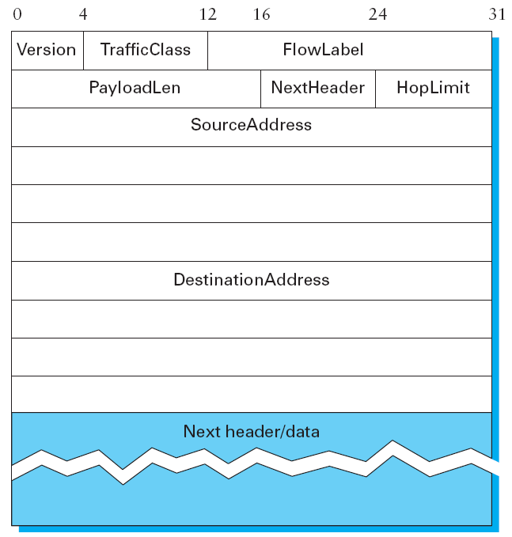
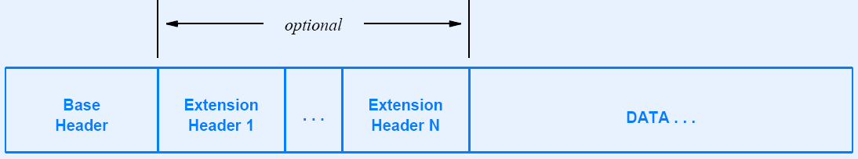
IPv6 Datagram
Notes:
IPv6 addresses do not have classes, but the address space is still subdivided in various ways based on the leading bits. Rather than specifying different address classes, the leading bits specify different uses of the IPv6 address.

Slide 26
Assigned IPv6 Prefixes
Binary Prefix
Hex Prefix
Usage
0000 0000
00
Reserved
001
2000::/3
Global Unicast
1111 1110 10
FE80::/10
Link Local
1111 1110 11
FEC0::/10
Site Local
1111 1111
FF00::/8
Multicast
For complete details, see http://www.ietf.org/rfc/rfc4291.txt
Notes:
First, the entire functionality of IPv4’s three main address classes (A, B, and C) is contained inside the 001 prefix. Aggregatable Global Unicast Addresses, as we will see shortly, are a lot like classless IPv4 addresses, only much longer. These are the main ones of interest at this point, with one-eighth of the address space allocated to this important form of address.
The idea behind “link local use” addresses is to enable a host to construct an address that will work on the network to which it is connected without being concerned about global uniqueness of the address.
Similarly, the “site local use” addresses are intended to allow valid addresses to be constructed on a site (e.g., a private corporate network) that is not connected to the larger Internet; again, global uniqueness need not be an issue.
Finally, the multicast address space is for multicast, thereby serving the same role as class D addresses in IPv4. Note that multicast
addresses are easy to distinguish— they start with a byte of all 1s.

Slide 27
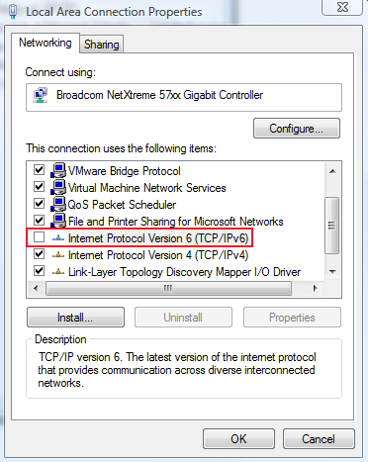
IPv6 on Microsoft Windows
First of all, TCP/ IPv6 must be enabled in the OS

Slide 28
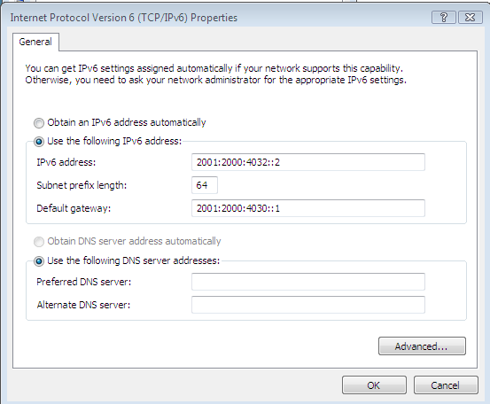
IPv6 on Microsoft Windows
IPv6 must then be configured (along with subnet prefix length)

Slide 29


References
Chapter 4:
Internetworking
Section 4.3.5; 4.1.8
[P&D]
Chapter on ICMP [Comer]

Slide 30
?
?
Questions/ Confusions?
?
Use the discussion forum at:
http://compnets.ning.com/
Credits/ Acknowledgement at:
http://sites.google.com/site/cse320site/

